Slide 1



WELCOME
2016 SPRING IPE DAY
Interprofessional Collaboration for Quality Care: Threading Sex and Gender Concepts into a Problem‐Based
Learning Model

Slide 2






IPE MULTIMEDIA CONTEST
ARE YOU TIRED OF READING BOOKS AND STUDYING BORING SLIDES?
WIN UP TO $700 FOR YOUR STUDENT ORGANIZATION
Turn your IPE idea into a fun, creative, innovative, and engaging multimedia educational program!
Open to all student organizations on all campuses. Collaboration across student organizations encouraged. For more information, official rules, and an entry form: ipe@ttuhsc.edu, www.ttuhsc.edu/ipe, or 806.743.2028
Are you interested in learning more about IPE and teaching others in new and creative ways?
Submit your IPE videos, visual arts, recorded performances, video skits, music, and/or other multimedia program by April 1, 2016. Winners announced
by May 1, 2016 and winning multimedia featured at the Annual Fall Symposium.
IPE PRIORITIES
Communication Collaborative Practice Inteprofessionalism Interprofessional Education
Interprofessional Case Studies Patient Safety
Patient-Centered Care Roles & Responsibilities
Teamwork Values and Ethics
1st prize: $700 2nd prize: $250 3rd prize: $100

Slide 3


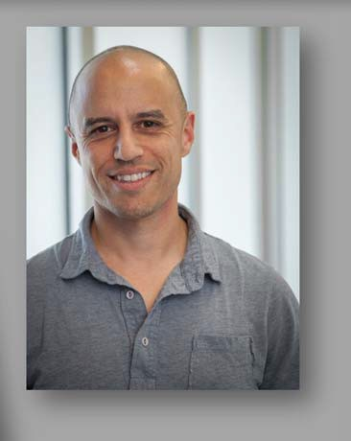


SAVE‐THE‐DATE: NOVEMBER 4, 2016 2016 FALL SYMPOSIUM
Zubin Damania aka
ZDoggMD!
Slightly Funnier than Placebo: Check out his music parodies at: www.youtube.com/user/ZDoggMD
Register for the 2016 Fall Symposium at:
https://ttuhsc‐ipe‐2016‐fall‐ symposium.eventbrite.com
www.zdoggmd.com
www.tedmed.com/talks/show?id=34752

Slide 4

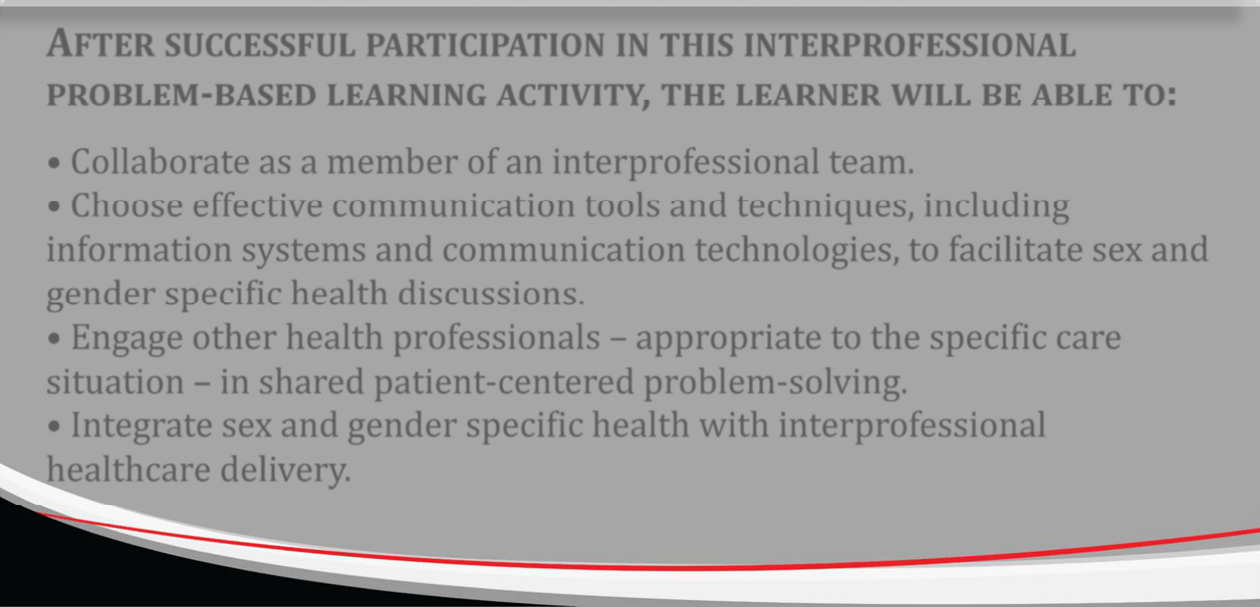
LEARNER OUTCOMES
AFTER SUCCESSFUL PARTICIPATION IN THIS INTERPROFESSIONAL PROBLEM‐BASED LEARNING ACTIVITY, THE LEARNER WILL BE ABLE TO:
Collaborate as a member of an interprofessional team.
Choose effective communication tools and techniques, including information systems and communication technologies, to facilitate sex and gender specific health discussions.
Engage other health professionals – appropriate to the specific care situation – in shared patient‐centered problem‐solving.
Integrate sex and gender specific health with interprofessional healthcare delivery.

Slide 5











WHAT IS PROBLEM‐BASED LEARNING?
Given a clinical problem.
Determine what knowledge you need to understand/solve the problem.
Identify and share the best resources for obtaining the needed information.
Collaborate and use your resources to acquire the knowledge you need.
Apply the gathered information back to the problem.
Collaborate with your team to come up with solutions.
Learner‐centered with active problem‐solving.
Learning through engagement with an authentic and highly relevant clinical problem.
Safe and open climate to share and learn about, from, and with others.
Promotes clinical reasoning, problem‐ solving, and clinical decision‐making skills.
Fosters communication, collaboration, and teamwork.

Slide 6

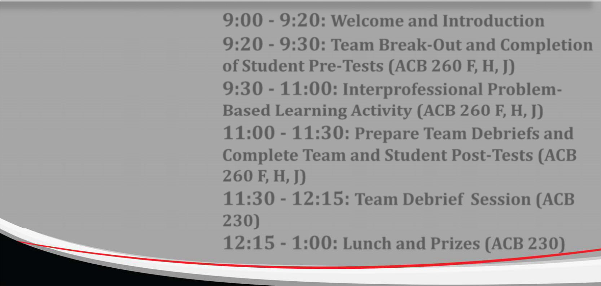

2016 SPRING IPE DAY AGENDA
9:00 ‐ 9:20: Welcome and Introduction
9:20 ‐ 9:30: Team Break‐Out and Completion of Student Pre‐Tests (ACB 260 F, H, J)
9:30 ‐ 11:00: Interprofessional Problem‐ Based Learning Activity (ACB 260 F, H, J)
11:00 ‐ 11:30: Prepare Team Debriefs and Complete Team and Student Post‐Tests (ACB
260 F, H, J)
11:30 ‐ 12:15: Team Debrief Session (ACB
230)
12:15 ‐ 1:00: Lunch and Prizes (ACB 230)

Slide 7


TEAM AND ROOM ASSIGNMENTS
ACB 260 F
Dr. Bogschutz (IPE) Dr. Phillips (SOM)
Te am 1: Cataclysmic Kickers
Kenneth Iwuji (SOM) Tiffany Revay (SHP) Matthew Ton‐That (SOM)
ACB 260 H
Dr. Sleeper (SOP) Dr. Casanova (SOM)
Te am 2: Smiling Shadows
Thien Hoang (SOP) Kelsea Loveless (SOM) Tori Rymer (SON Celina Truong (TTU)
ACB 260 J
Dr. Sechrist (SHP) Dr. Masten (SON)
Te am 3: The Minion Dominions
Marlee DeMots (SHP) Ashley Ford (SON) Britni Montague (SOP) Timothy Wilson (SOM)
Te am 6:
Barbara Ballew (GSBS) Clayton Bandy (SOP) Jessica Krahl (SHP) Alaa Ramadan (SOM)
Te am 4:
Sashelly Garcia (SHP) Alicia Martinez (SON) Kathryn Okolo (SOP) Anastasia Ruia (SOM)
Te am 5:
Amy Coulson (SHP) Amanda Murray (SOM)
Ravi Rajmohan (GSBS, SOM)

Slide 8

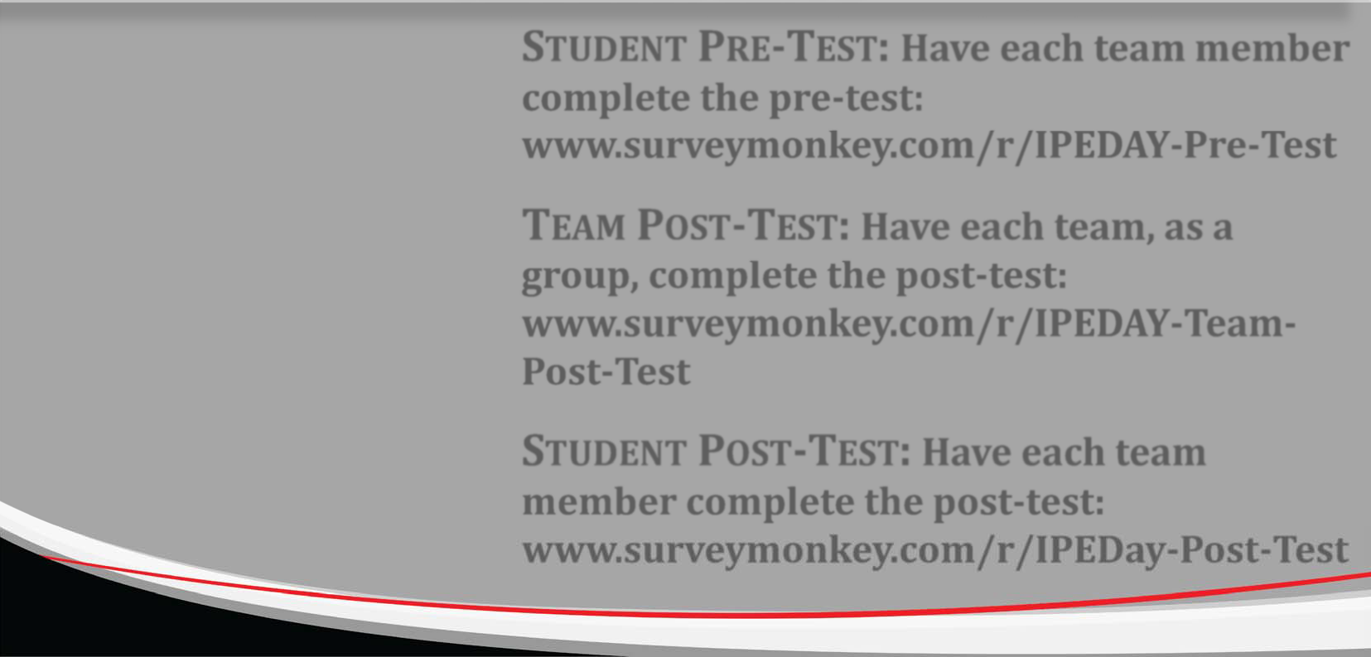

ASSESSMENT
STUDENT PRE‐TEST: Have each team member complete the pre‐test: www.surveymonkey.com/r/IPEDAY‐Pre‐Test
TEAM POST‐TEST: Have each team, as a group, complete the post‐test: www.surveymonkey.com/r/IPEDAY‐Team‐ Post‐Test
STUDENT POST‐TEST: Have each team member complete the post‐test: www.surveymonkey.com/r/IPEDay‐Post‐Test

Slide 9

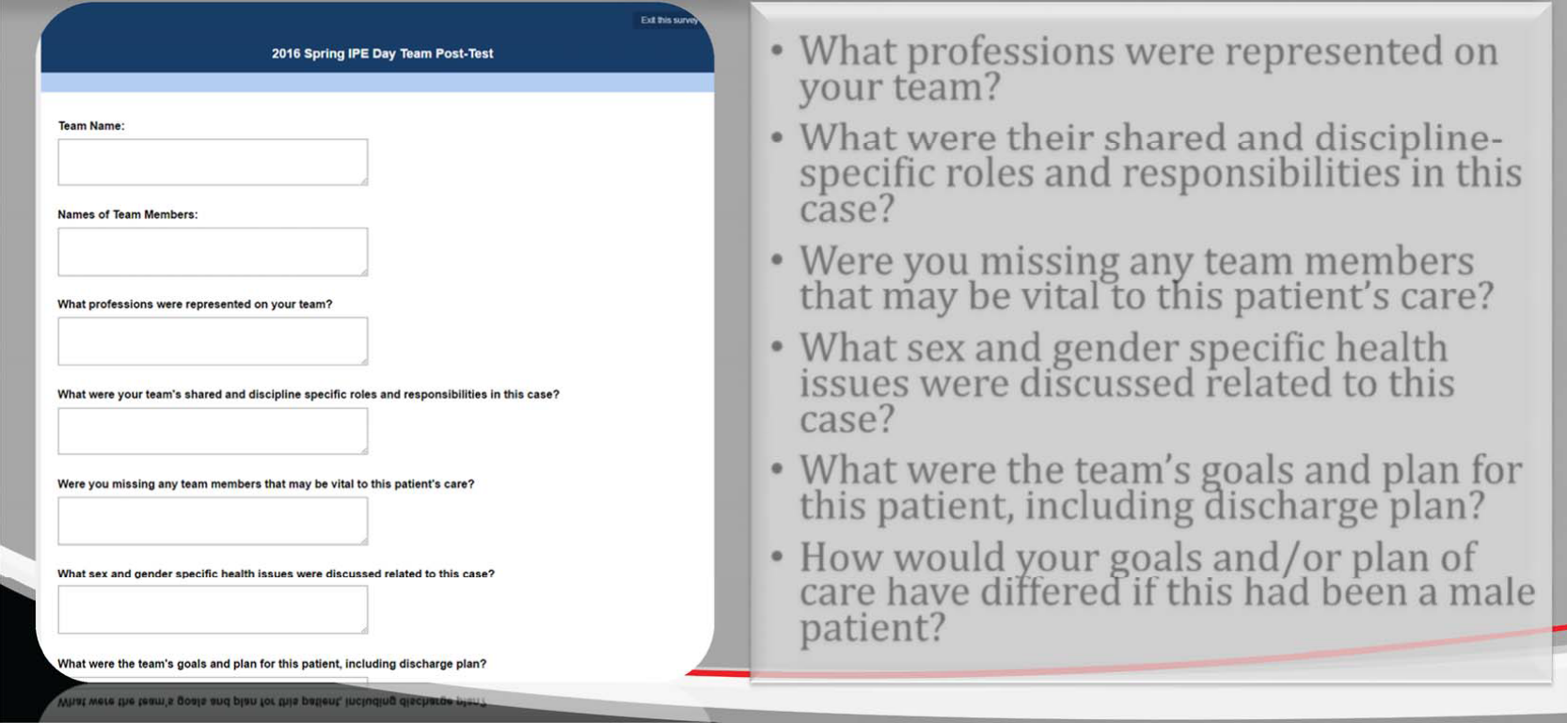
TEAM POST‐TEST QUESTIONS RELATED TO THE PBL CASE
What professions were represented on your team?
What were their shared and discipline‐ specific roles and responsibilities in this case?
Were you missing any team members that may be vital to this patient’s care?
What sex and gender specific health issues were discussed related to this case?
What were the team’s goals and plan for this patient, including discharge plan?
How would your goals and/or plan of care have differed if this had been a male patient?

Slide 10
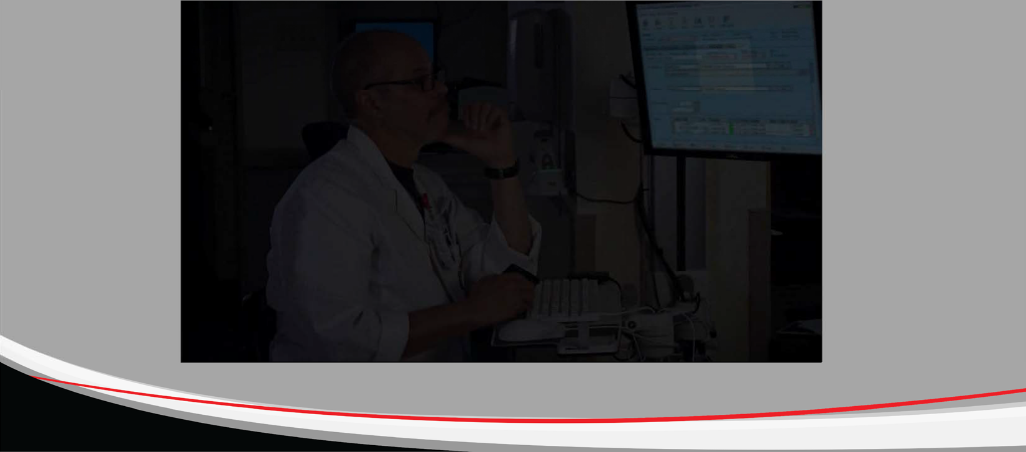
VIDEO HISTORY AND PHYSICAL

