Slide 1

Where to Go When You Want to Know About Sex and Gender Specific Medicine
Janice Werbinski MD, FACOG
Associate Clinical Professor Emerita, ObGyn
Western Michigan University Homer Stryker School of Medicine
Executive Director, Sex and Gender Collaborative
MWIA CENTENNIAL MEETING: SEX AND GENDER SPECIFIC MEDICINE SESSION

Slide 2

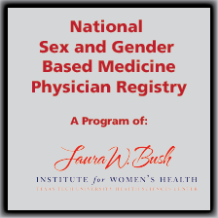
The Sex and Gender Health Collaborative
An Umbrella SGBM Organization
Initiative of the American Medical Women’s Association
Membership is Free! – sign up on the site
www.amwa-doc.org/sghc
Online community of SGBM educators, practitioners, researchers, students
SGBM teaching tools, curricular materials, presentations, guidelines
"In This Case", a collection of SGBM case studies
National SGBM Practitioner Registry, searchable for patients and practitioners
Notes:
I am the ED of SGWHC. For more questions, ask me or Nikki Miller, our Media Specialist, who will be here at the conference both days.

Slide 3
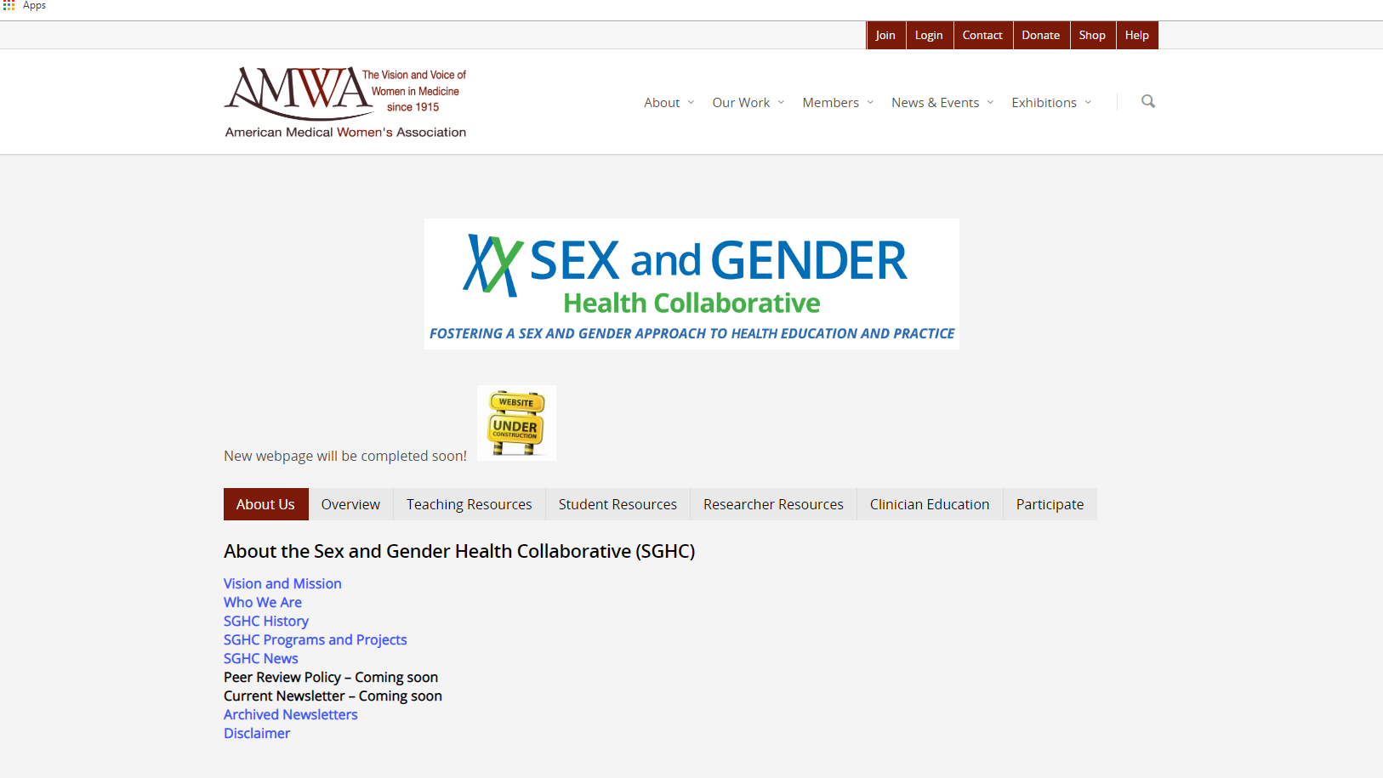

Slide 4
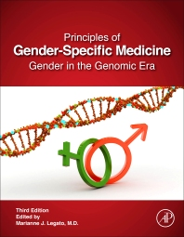
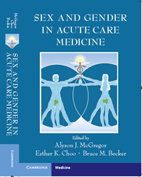
References and Textbooks
Principles of Gender Specific Medicine:
Gender in the Genomic Era Marianne Legato. Elsevier, 2017
Sex and Gender in Acute Care Medicine
Alyson J. McGregor. Cambridge, 2016
How Sex and Gender Impact Clinical Practice:
An Evidence Based Guide to Clinical Care
Marjorie Jenkins and Connie Newman, Elsevier, 2020
(In Press)
Notes:
Mary Ann Legato’s two volume text. 2d edition. Considering a 3d. Alyson’s hot off the press and available for orders today.

Slide 5
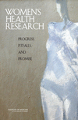

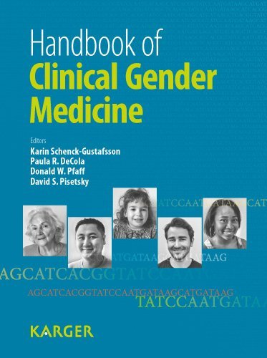


Other Books

Slide 6
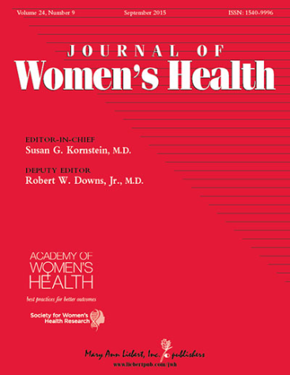

SGBM Journals
Journal of Women’s Health
and Gender Based Medicine
Liebert Pub
Gender and the Genome
Sage
Biology of Sex Differences
Biomed Central
Notes:
The Journal of Women’s Health recently expanded the name to JWH and Gender Based Medicine. Biology of Sex Differences is an online journal. Gender Medicine has been discontinued, but older issues remain on that website.

Slide 7

Educational Resources
Texas Tech University Health Sciences Center
Pub Med
Search Tool
www.sexandgenderhealth.org
PBL, TBL FLIPPED CLASSROOM
Notes:
Summit Attendees will have access to these resources for 45 days after the conference today. After that, go to the sexandgenderhealth.com website to learn about subscriptions for individuals and institutions

Slide 8
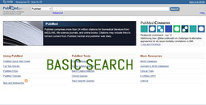
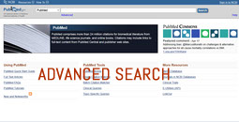
Pub Med Search Engine Tools
www.sexandgenderhealth.org

Slide 9









Other Educational Resources
Medical Women’s International Association
Please add to the WIKI
Gendered Innovations employs methods of sex
and gender analysis to create new knowledge.
GenderMed DB
(GenderMedDB) is a systematic archive of scientific
publications analysing sex and gender differences.

Slide 10
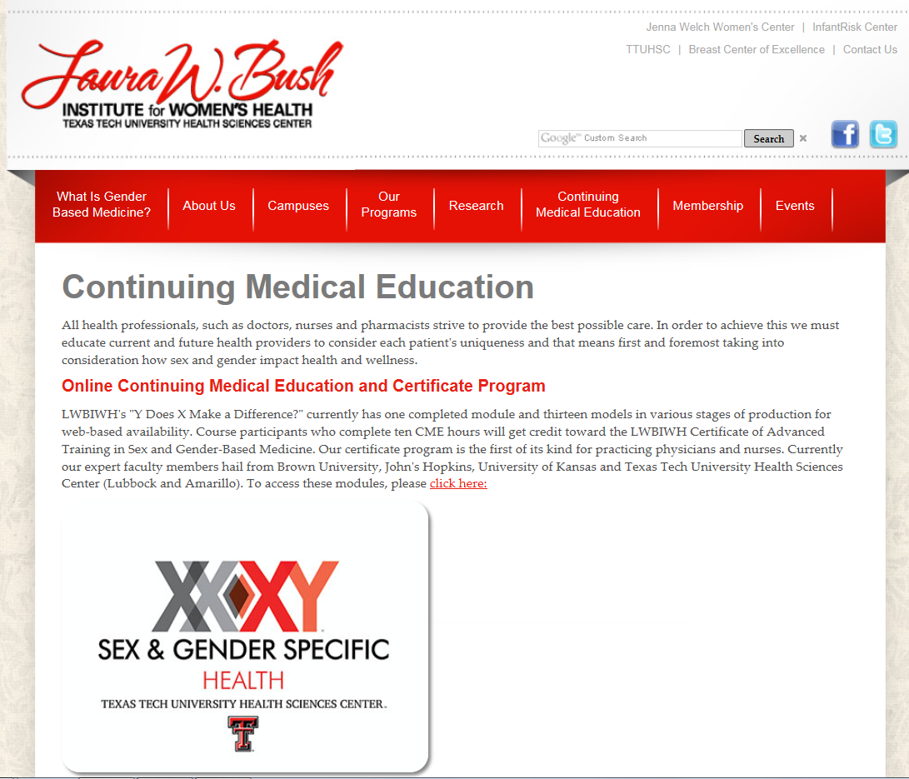
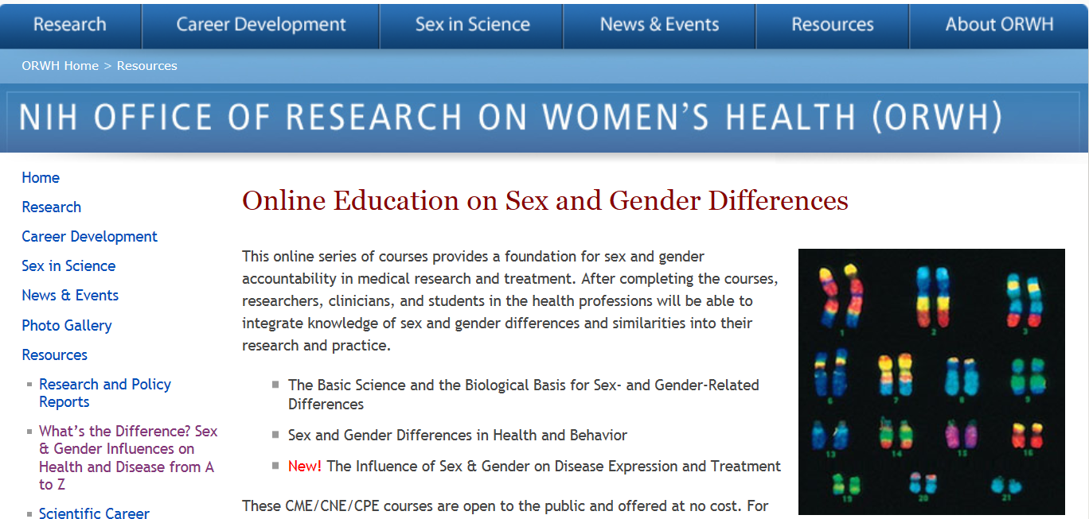
Online Medical Education
www.LauraBushInstitute.Org
https://sexandgendercourse.od.nih.gov/
Notes:
Y Does X Make A Difference FREE CME modules. Each gives 1 hour of CME in SGBM

Slide 11


SGBM/SGHE Summit Proceedings
2015
Sex and Gender Medical Education Summit
2018
Sex and Gender Health Education Summit
www.sgbmeducationsummit.com
www.sghesummit2018.com
(In Press)

Slide 12




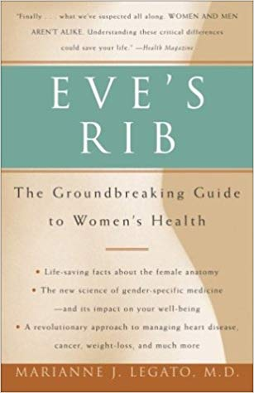
From the Lay Press
Women are Dying Because Doctors Treat Us Like Men
Marie Claire Magazine – May, 2017
Why Are So Many Women Being Misdiagnosed?
Glamour Magazine - August, 2017
Why the New Science of Sex and Gender Matters for Everyone
September, 2017
The Truth About How Bad Medicine and Lazy Science
Leave Women Dismissed, Misdiagnosed, and Sick
May, 2018
How the New Study of Gender Specific Medicine
Can Save Your Life, 2002a Sick”
May 2017:
Marie Claire
Sept 2017:
Scientific American
May 2018

Slide 13
Present and future needs
What You Can Do As an Individual
Simply ask the question:
        “How might this appear in the other sex?”
        Add 2 slides to any lecture about presentation in the other sex
        Ask the question in journal clubs, rounds, and other learning venues

